Slide 1
Welcome, Booz Allen Hamilton!
Data Science Fundamentals
Wave 13 January 2021

Slide 2

WHO IS GENERAL ASSEMBLY?
We empower people to do work they love through education in technology, business, and design.
Notes:
Learning Journey - Option 2
Can Delete or Add additional Phases, can use GA Image Library Addon for Icons + Photos. If adding more phases, follow the color order referenced in the Enterprise Master Deck Slide 2

Slide 3
LEARNING APPROACH
CULTURE OF FEEDBACK
COLLABORATION
PROJECT BASED LEARNING
ACTIVE LEARNING
Notes:
Learning Journey - Option 2
Can Delete or Add additional Phases, can use GA Image Library Addon for Icons + Photos. If adding more phases, follow the color order referenced in the Enterprise Master Deck Slide 2

Slide 4


MEET YOUR INSTRUCTORS
4 | © 2019 General Assembly
Notes:
- All Instructors and Experts in Residence should come up to the front of the room for an introduction highlighting their work experience and areas of expertise.

Slide 5

ROAD TO SUCCESS
5 | © 2019 General Assembly

Slide 6
FEEDBACK/SUPPORT
Access to Instructional Team: Asking questions in class (come off mute, raise your hand, or post in the Slack channel, 1:1 Office Hours)
Slack: Info, Help, Q&A, Dialogue
Exit Tickets (end of each class)
Mid-Course Feedback
End of Course Feedback

Slide 7
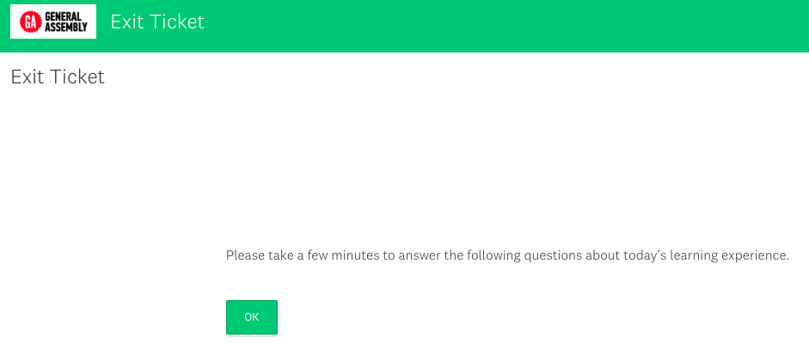
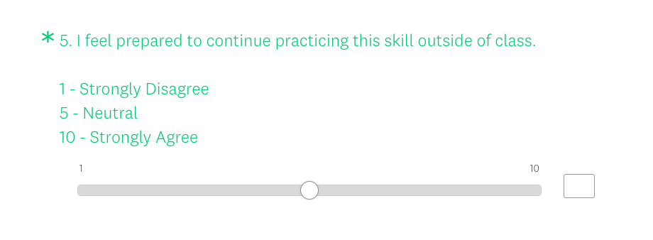
EXIT TICKETS
WHAT: “pulse check” after each class, gauging participant reaction to content and instruction
WHY: helps GA understand impact of instruction and how/where to adapt
TIMING: issued at the end of each class
PLEASE NOTE: completion provides instructors with powerful visibility on where/how to support!
Notes:
The exit ticket is an important way that your instructional team will be collecting feedback. After every session, you can log on to schoology to find the ticket. We’ll be going over them as an instructional team weekly. Please keep it actionable and thoughtful.

Slide 8
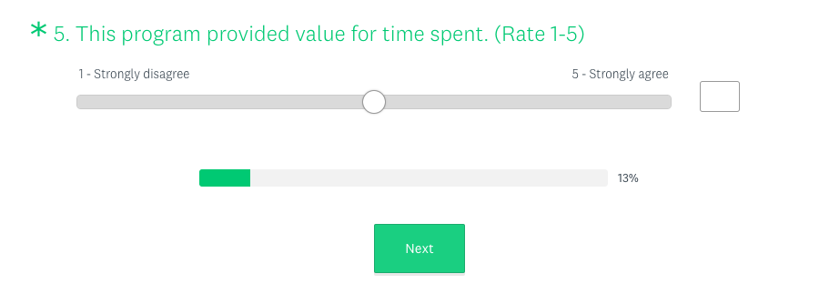
PROGRAM SURVEYS
WHAT: program-wide survey, covering content, instruction, and overall impact
WHY: helps GA understand overall program effectiveness, and where to improve
TIMING: issued at mid- and end-points of class
PLEASE NOTE: completion is required to graduate!
Notes:
The exit ticket is an important way that your instructional team will be collecting feedback. After every session, you can log on to schoology to find the ticket. We’ll be going over them as an instructional team weekly. Please keep it actionable and thoughtful.

Slide 9




COURSE COMPLETION REQUIREMENTS
ATTENDANCE & ENGAGEMENT
(miss no more than
2 classes)
SATISFACTORY
PROJECT WORK
(pass 80% or better on all course projects)
PROGRAM SURVEYS & REASSESSMENT
(must complete all to “graduate”)
CERTIFICATE OF COMPLETION
(sent by GA after course concludes)
Notes:
Learning Journey - Option 2
Can Delete or Add additional Phases, can use GA Image Library Addon for Icons + Photos. If adding more phases, follow the color order referenced in the Enterprise Master Deck Slide 2

Slide 10
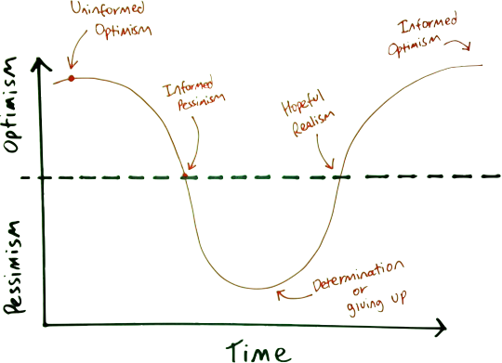
EMOTIONAL CYCLE OF CHANGE
Notes:
In Washington, attendance is taken by teachers fifteen (15) minutes after class begins and fifteen (15) minutes prior to class ending. Any student who arrives to class more than 15 minutes late will be marked tardy and any student who is not present 15 minutes prior to class ending will be marked early departure. Three late arrivals and/or early departures will constitute one absence. G
COMPLETION
A Letter of Completion is issued within 7 days of the end of the course to each student who has successfully fulfilled the General Assembly requirements of obtaining a “Pass” in a course.

Slide 11

QUESTIONS
Notes:
In order to be considered a “graduate of our programs” you must complete the following:
80% of project milestones meet expectations
Miss no more than 2 class sessions
Submit a final project
participate in our larger mid-course and end-of-course feedback surveys
These are rules we put in place make sure that you get your money’s worth out of the program.

Slide 12

INTRODUCTIONS
Post 2 clues about where you are from or favorite city to travel.
Reply to other student’s postings to guess their response based on the clues.
Notes:
Icebreaker time! Have students go around the room and introduce themselves. It’s a great way to get them to loosen up and meet each other, and to start to get comfortable speaking in front of the class!

Slide 13
WELCOME TO
DATA SCIENCE

Slide 14
LEARNING OBJECTIVES
Set up and confirm your development environment.
Define the Data Science Workflow and common Machine Learning concepts.
Discuss the topics and goals of our course.

Slide 15
INTRODUCTION
WHAT IS DATA SCIENCE?

Slide 16

DATA SCIENCE IN REAL WORLD
In Slack, list a product or service that uses data science.

Slide 17


EYES IN THE SKY HELP FARMERS ON THE GROUND
Aerial imaging companies using high-resolution cameras and artificial intelligence data analysis are giving the agricultural community a high-tech boost. NYTimes, Lauren Smiley, Sept. 8, 2019
17 | © 2019 General Assembly

Slide 18

WHAT IS DATA SCIENCE?
At a high level:
Application of machine learning to solve real world problems
Capable of creating immense value in everyday life
Notes:
Two basic statements on applying machine learning to create value
Using the old tried and true diagram to show where the definition started (moving toward standards board)
As the field matures this diagram starts to become less relevant.
Specialities are appearing – new subdisciplines are arising – more time is needed to refine new areas

Slide 19
One problem: trying to agree on a definition for data science.
Notes:
Goal: Demonstrate that we are so far from getting there because we don’t’ even know what we’re aiming at

Slide 20






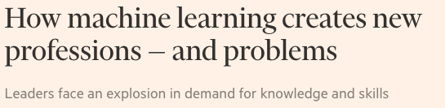
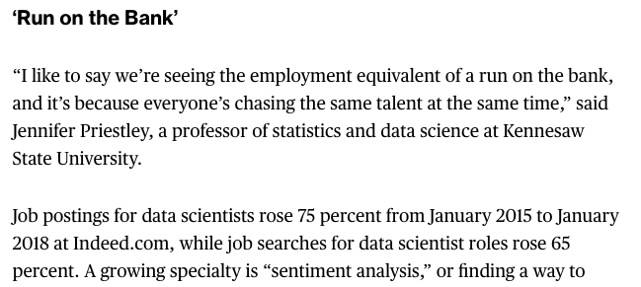

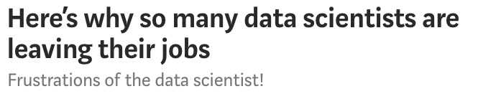
No definition and no roadmap while demand increases
Notes:
This lack of knowing what we’re aiming at creates a painful plethora of problems… 10 points if you say that phrase in a meeting
Links:
https://www.bloomberg.com/news/articles/2018-05-18/-sexiest-job-ignites-talent-wars-as-demand-for-data-geeks-soars
https://www.mckinsey.com/~/media/McKinsey/Business%20Functions/McKinsey%20Analytics/Our%20Insights/The%20age%20of%20analytics%20Competing%20in%20a%20data%20driven%20world/MGI-The-Age-of-Analytics-Executive-summary.ashx
https://www.burning-glass.com/research-project/quant-crunch-data-science-job-market/
https://www.oreilly.com/ideas/data-engineers-vs-data-scientists
https://www.forbes.com/sites/louiscolumbus/2017/05/13/ibm-predicts-demand-for-data-scientists-will-soar-28-by-2020/#a4e3e077e3bd
https://www.ft.com/content/49e81ebe-cbc3-11e7-8536-d321d0d897a3
https://towardsdatascience.com/why-so-many-data-scientists-are-leaving-their-jobs-a1f0329d7ea4

Slide 21
DEFINITION ALIGNMENT
Data science is the practice of:
acquiring, organizing and delivering complex data,
discovering relationships and anomalies among variables,
building and deploying machine learning models,
and synthesizing data to influence decision making.

Slide 22
Why do we care about Data Science?

Slide 23
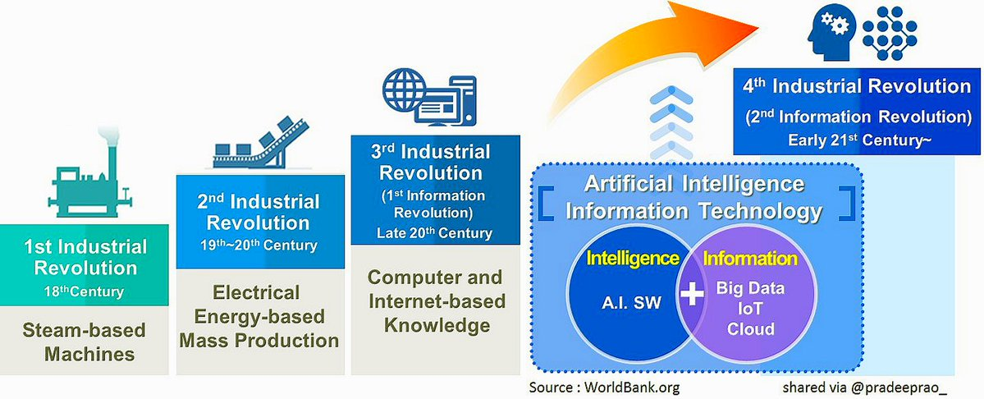
NEW INDUSTRIAL REVOLUTION
Big data, immense advances in processing power, machine learning and Data Science are at the forefront of an explosive new chapter in human history.
Notes:
Everyone’s talking about it. Hop on google and you’ll see – well google, amazon, apple, salesforce, forbes, world bank, time magazine etc
“Mastering the Fourth Industrial Revolution” was the theme of the World Economic Forum Annual Meeting 2016 in Davos-Klosters, Switzerland.

Slide 24
NEW CORPORATE CURRENCY
Creation of new data accelerates every year. Modern GPU’s are creating more processing power than ever:
Connected Homes
Connected Workspaces
Connected Cities
Connected Cars
Connected Wearables

Slide 25


WHAT YOU DON’T KNOW ABOUT HOW FACEBOOK USES YOUR DATA
The social-media giant also collects so-called biometric facial data without users’ explicit “opt-in” consent, and helps video-game companies target “high-value players” who are likely to spend on in-app purchases. Seattle Times, Natasha Singer, April 11, 2018
25 | © 2019 General Assembly
25 | © 2019 General Assembly

Slide 26









WHO USES DATA SCIENCE?

Slide 27

ASKING GOOD QUESTIONS
27 | © 2019 General Assembly

Slide 28
WHY DO WE NEED A GOOD QUESTION?
“A problem well stated is half solved.” — Charles Kettering
Even though all data science projects have different general flows, they start in the same place: with a problem.
From this problem statement arises questions; questions we will ask the data in order to gain more information so we can attempt to find a solution to that problem.

Slide 29
COMPONENTS OF A GOOD QUESTION
Sets you up for success as you begin analysis.
Establishes the basis for reproducibility.
Enables collaboration through clear goals.

Slide 30
SMART FRAMEWORK
Specific: The data set and key variables are clearly defined.
Measurable: The type of analysis and major assumptions are articulated.
Attainable: The question you are asking is feasible for your data set and not likely to be biased.
Reproducible: Another person (or future you) can read and understand exactly how your analysis is performed.
Time-bound: You clearly state the time period and population to which this analysis pertains.

Slide 31
SMART GOAL
Make a goal for this class with a partner.
Use the SMART Goals Framework to make sure that it's specific, measurable, attainable, reproducible, and time-bound.

Slide 32
What Are Some Common Questions Asked in Data Science?
Machine learning more or less asks the following questions:
Does X predict Y? (Where X is a set of data and y is an outcome.)
Are there any distinct groups in our data?
What are the key components of our data?
Is one of our observations “weird”?
From the business the ask is often:
What is the likelihood that a customer will buy this product?
Is this a good or bad review?
How much demand will there be for my service tomorrow?
Is this the cheapest way to deliver my goods?
Is there a better way to segment my marketing strategies?
What groups of products are customers purchasing together?

Slide 33
The Data Science Workflow

Slide 34
DATA SCIENCE WORKFLOW OVERVIEW
A methodology for doing Data Science
Like the scientific method
Helps produce reliable and reproducible results
Reliable: Accurate findings
Reproducible: Others can follow steps and get same results

Slide 35
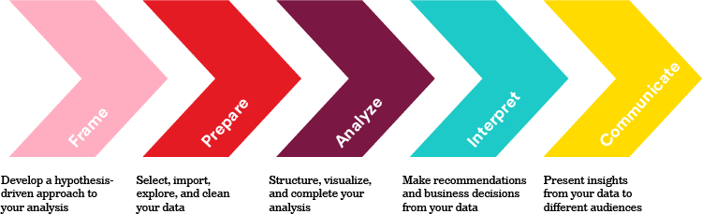
DATA SCIENCE WORKFLOW OVERVIEW

Slide 36
Application: Data Science Workflow Through Ames Data
What is Ames Data?
DESCRIPTIVE ABSTRACT: Data set contains information from the Ames Assessor’s Office used in computing assessed values for individual residential properties sold in Ames, IA from 2006 to 2010.
Why are you getting Ames Data?
For many of our lessons, projects and activities we’ll be providing you access to various datasets to explore, discover and build analysis upon. It provides a common reference point for learning
Ideal Data vs. Available Data
Oftentimes, we'll start by identifying the ideal data we would want for a project, but as data is acquired, we realize the limitations of the data and must decide if it is enough to find a reasonable conclusion.

Slide 37
VOCABULARY
Features
The various measurements (or variables) in your data set. Here it might include variables such as square footage or number of bedrooms.
Features will always be the columns in the data set in you're working with. You can often think of them as your 𝑥x (or independent) variables.

Slide 38
VOCABULARY
Observations
Observations are the individuals you record features for. These might be people, houses, transactions, or just about anything else.
Observations will always be the rows in your dataset.

Slide 39

VOCABULARY

Slide 40
FRAME
Identify the business/product objectives.
Identify and hypothesize goals and criteria for success.
Create a set of questions to help you identify the correct data set.
We work for a real estate company interested in using data science to determine the best properties to buy and resell. Specifically, your company would like to identify:
Characteristics of residential houses that predict their sale price
Cost-effectiveness of doing renovations.

Slide 41
FRAME
Identify the Business/Product Objectives
The customer tells us their business goals are to accurately predict prices for houses (so that they can sell them for as large a profit as possible) and to identify which kinds of features in the housing market would be more likely to lead to foreclosure and other abnormal sales (which could represent more profitable sales for the company).
Identify and Hypothesize Goals and Criteria for Success
Ultimately, the customer wants us to:
Deliver a presentation to the real estate team.
Write a business report discussing results, procedures used, and rationales.
Build an API that provides estimated returns.
Create a Set of Questions to Help You Identify the Correct Data Set
Can you think of questions that would help this customer deliver on their business goals?
What sort of features or columns would you want to see in the data?

Slide 42
Rules of Thumb
Always find a SME and stay in touch with the business on progress/findings
~80 percent of solving a machine learning problem is just having good, useful data to start with. (At this stage, it's common to realize that the problem you're trying to solve may not be solvable with the information available.)
The more data you can collect, the better. You never know what features might turn out to be important!
The more that one particular feature would predict the outcome, the more effort you should put into collecting it. (This will likely require some reasonable speculation on your part.)

Slide 43
Prepare: Understand Dataset
Take a moment to look through the data description. How closely does the set match the ideal data that you envisioned? Would it be sufficient for our purposes? What limitations does it have?
What are some questions we should ask during the acquisition process?
What are some questions we should ask when checking the data for quality?

Slide 44
Data Quality
Where are the data coming from?
How do the data fit together?
Are there enough data?
Do our data appropriately align with the question/problem statement?
Can the data set be trusted? How was it collected?
What are necessary resources, requirements, assumptions, and constraints?

Slide 45
PREPARE
Common considerations when preparing our data include:
Ensuring data is clearly defined and structured
Check and clean data formatting as needed
Common considerations for cleaning include:
Most data will not come perfectly clean and ready to use. Cleaning data is normally the most time-consuming task a data scientist faces.

Slide 46
PREPARE
Reading any documentation provided with the data (e.g., the data dictionary above).
Describing the data structure and the information being collected.
Performing exploratory surface analysis via filtering, sorting, and simple visualizations.
Formatting and cleaning data in Python (e.g., dates, number signs, formatting).
Determining most appropriate methods for aggregating, cleaning missing values, etc.
Creating the necessary derived columns from the data (new data).

Slide 47
ANALYZE
As an example of basic statistics, data scientists often check the mean, standard deviation, or specific frequency counts of their data. Statistics that we might expect for the earlier housing variables include:
Variable | Mean or Frequency (%)
Square Footage | 2201.3
Street Type - Gravel | 8%
Street Type - Paved | 92%
Number of Bedrooms | 1.8

Slide 48
ANALYZE
Creating a Predictive Model
Generate predictive models based on the SMART goal we decided upon earlier.
Typically, predicting or guessing some sort of value we might be interested in (such as the housing price for a house given some set of fixed characteristics).
What are some other business goals we can support as data scientists for this realty company? What are some values we would like to guess?

Slide 49
INTERPRET
Now that you have a model, what are some things you should check?
Can you convert your model’s findings into a conclusion or next step?

Slide 50
INTERPRET
Did we reject or fail to reject our hypotheses?
Interpret what this means for your project.
Interpret what this means for your client.
Did we answer our initial questions?
Clarify what do you need to do to answer the ones that weren't.
Can we develop business recommendations, actions, or decisions?
Determine if there is further supportive analysis required.
Clarify how your data support these recommendations.

Slide 51
COMMUNICATE
Presentations are a critical part of your analysis. It doesn't matter how brilliant your model is or how illuminating your findings are — without effective communication, your work will not be used.
The most basic form of a data science presentation should include a simple sentence that describes your results:
"Customers from large companies had twice (CI 1.9, 2.1) the odds for placing another order with Planet Express compared to customers from small companies."
Data science presentations can also be far more complex and exciting, like some of the research presented by Nate Silver's FiveThirtyEight blog.
Notes:
Consider the audience

Slide 52
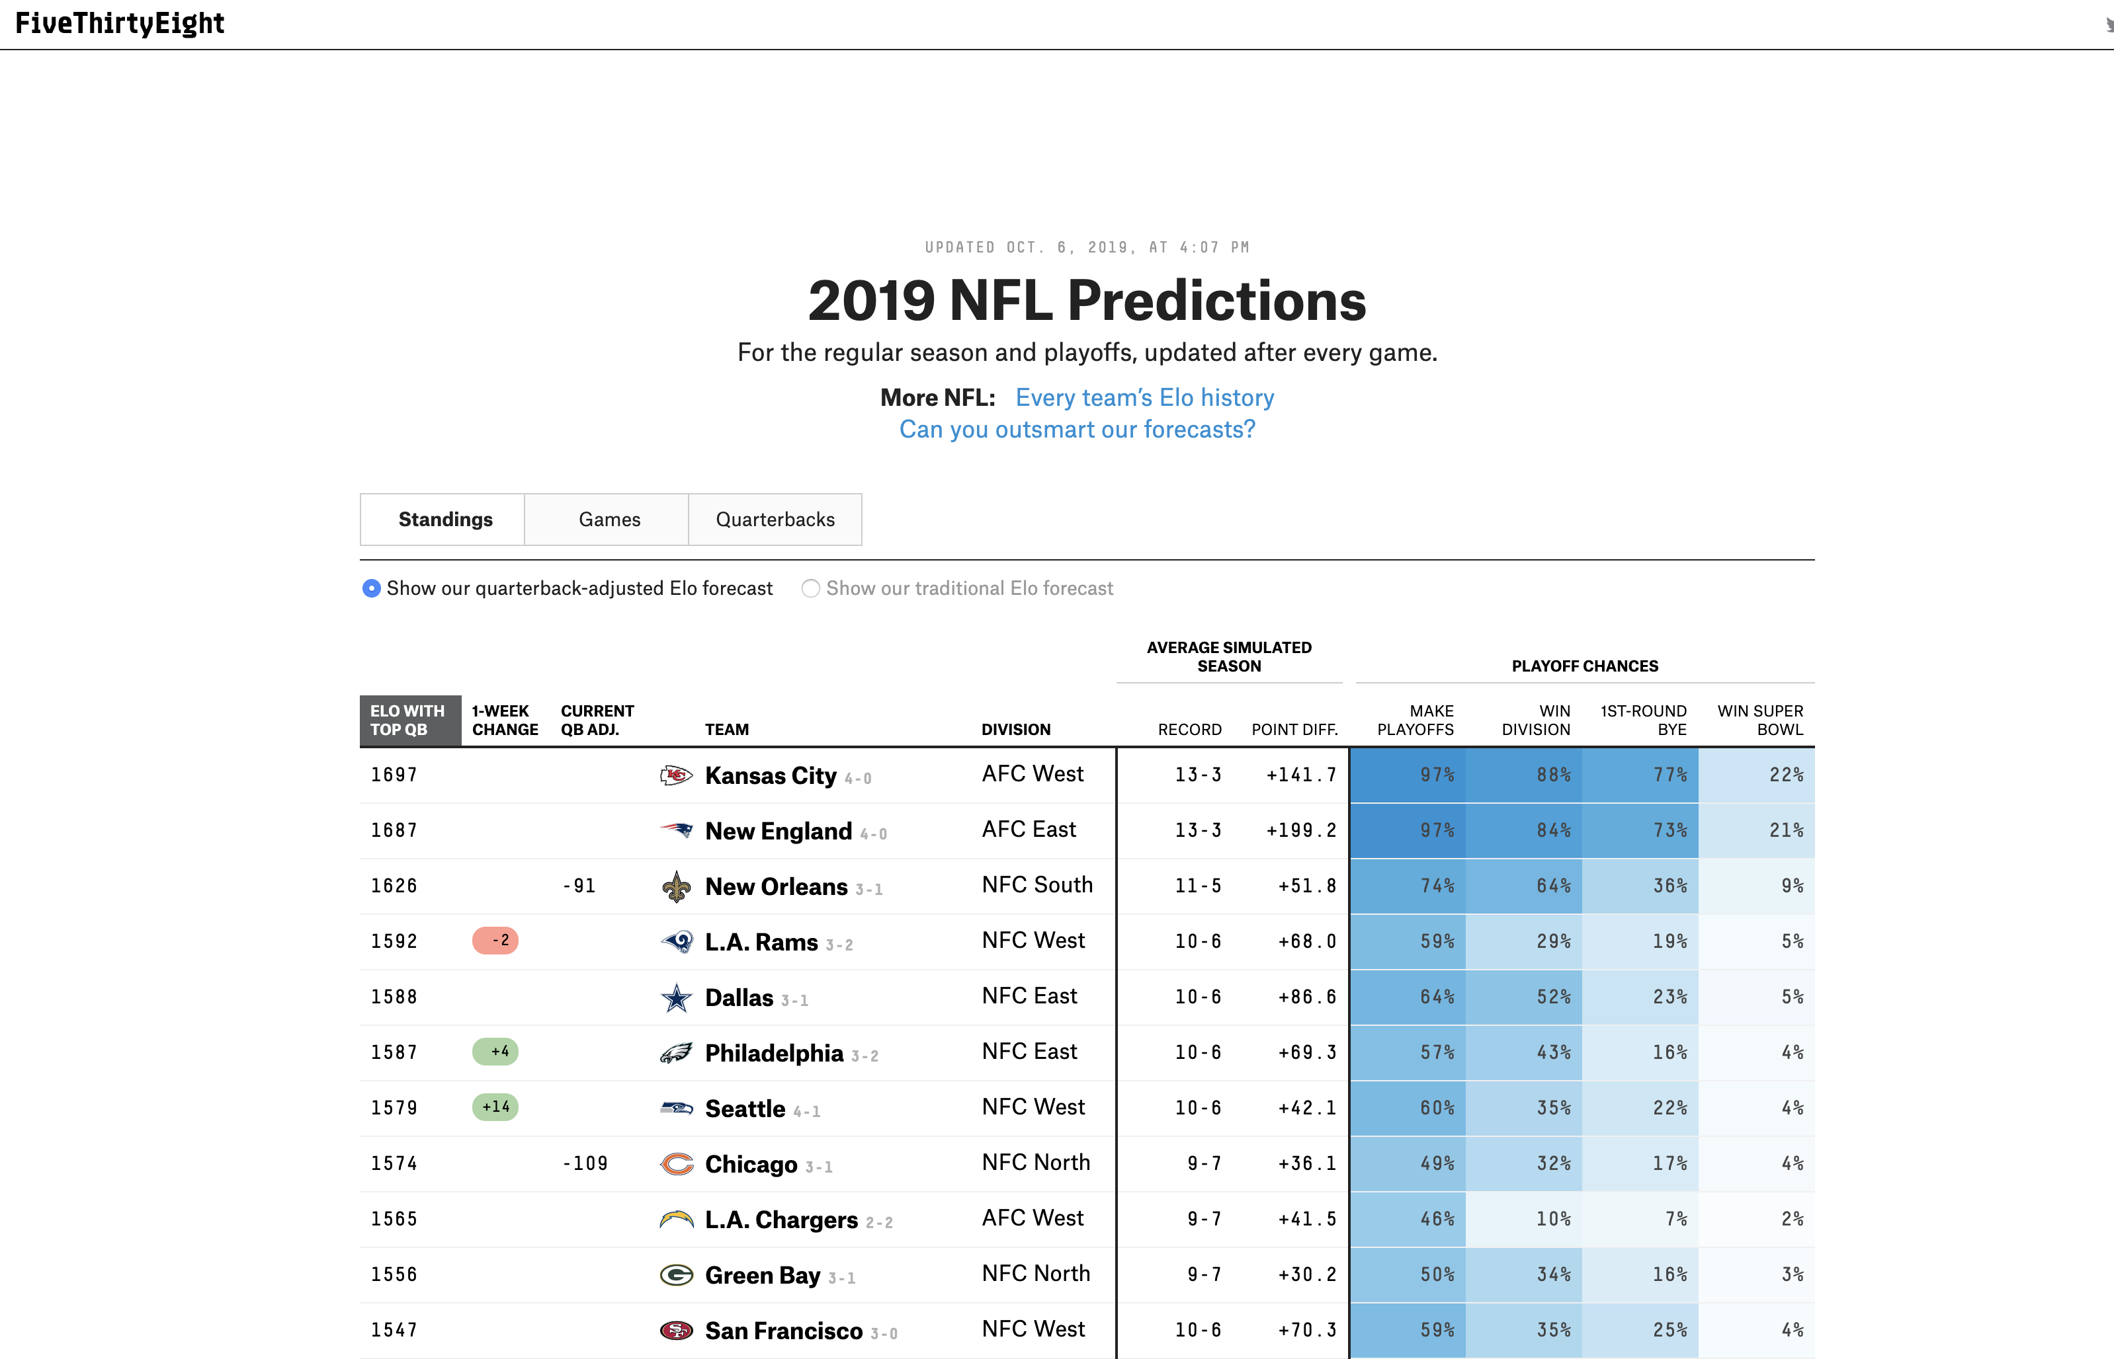

Slide 53
Machine Learning

Slide 54
MACHINE LEARNING TERMINOLOGY
Supervised learning (a.k.a., “predictive modeling”):
Classification and regression
Predicts an outcome based on input data
Example: Predicts whether an email is spam or ham.
Attempts to generalize
Requires past data on the element we want to predict (the target)

Slide 55
MACHINE LEARNING TERMINOLOGY
Unsupervised learning:
Clustering and dimensionality reduction
Extracts structure from data
Example: Segmenting grocery store shoppers into “clusters” that exhibit similar behaviors.
Attempts to represent
Does not require past data on the element we want to predict.

Slide 56
SUPERVISED LEARNING
Most frequent type of work that data scientists do and will be the main focus of this course. How does supervised learning work?
We train a machine learning model (more on that shortly) using labeled data (the "response" label from earlier).
We make predictions on new data for which the response is unknown.
The primary goal of supervised learning is to build a model that “generalizes” — i.e., accurately predicts the future rather than the past!

Slide 57
CLASSIFICATION VS. REGRESSION
There are two categories of supervised learning:
Regression
The outcome we are trying to predict is a continuous value.
Can you think of anything we would want to predict like this?
Classification
The outcome we are trying to predict is categorical (i.e., it comes in one of a set number of classes).
Can you think of anything that we would want to predict like this?
The type of supervised learning problem has nothing to do with the features; only the response matters!

Slide 58


Slide 59
UNSUPERVISED LEARNING
Common Types of Unsupervised Learning
Clustering: Groups “similar” data points together.
Dimensionality reduction: Reduce the dimensionality of a data set by extracting features that capture most of the variance in the data.
Types of Customers at a Bar
Observations: Customers.
Features: Drink purchases, people they interact with, etc.
Response or target variable: There isn’t one — instead, we group similar customers together.

Slide 60
UNSUPERVISED LEARNING
Common Types of Unsupervised Learning
Clustering: Groups “similar” data points together.
Dimensionality reduction: Reduce the dimensionality of a data set by extracting features that capture most of the variance in the data.
Types of Customers at a Bar
Observations: Customers.
Features: Drink purchases, people they interact with, etc.
Response or target variable: There isn’t one — instead, we group similar customers together.

Slide 61



CLUSTERING

Slide 62
GROUP ACTIVITY: COVID-19 Is A Data Science Issue
COVID-19 Is A Data Science Issue
Sketch out answers to the following:
What is a potential target in your data for a regression model?
What is a potential target in your data for a classification model?
Could unsupervised learning be used within this data? How so?
Pick one of your targets and sketch out what a data science workflow would look like for that question. Identify what you think would be most important during each step:
Frame: Develop a hypothesis-driven approach to your analysis.
Prepare: Select, import, explore, and clean your data.
Analyze: Structure, visualize, and complete your analysis.
Interpret: Derive recommendations and business decisions from your data.
Communicate: Present (edited) insights from your data to different audiences.

